Slide 1
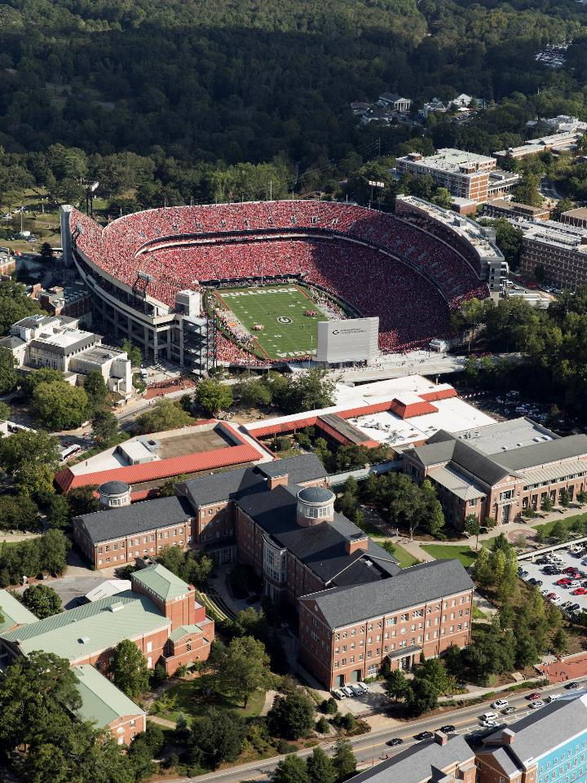
5-5-5 New Employee Onboarding Experience

Slide 2
Welcome Letter
First 5 Days
First 5 Weeks and First 5 Months
FY 24 Important Dates
Bulldawg Buddy
DAR Dictionary
3
4
6
7
8
9
Notes:
Top left header is cut off and you can't read it (pages 2-9).

Slide 3
We are so glad that you have decided to be a part of our team. In this packet, you will find pages filled out by your supervisor that outline your first 5 days, 5 weeks, and 5 months in this position. You will also find information about resources the university offers as well as the contact information from your Bulldawg Buddy, a coworker assigned to you by your supervisor who will help you in your transition to your new role. If you have any questions, feel free to reach out to Cristy Jones, Talent Management Specialist, cristy.jones25@uga.edu. Again, we are so glad you are here, and we hope you have a smooth start to your new job.
Notes:
Cristy, I would add your title and email address in the second to last sentence of this welcome letter.

Slide 4
First Five Days
Day 1 | Time
Day 2 | Time
Day 3 | Time

Slide 5
First Five Days (cont’d)
Day 4 | Time
Day 5 | Time

Slide 6
Five Weeks
Five Months

Slide 7
FY24 Important Dates
Development Meetings: For all Development Staff
Division Meetings: For all Division Staff
DAR 101: Onboarding Day for New DAR Employees
Notes:
Do we refer to Division Meetings as DAR Town Hall? Specific dates will need to be added.

Slide 8
Bulldawg Buddies
Meet Your Bulldawg Buddy!
Name:
Job Title:
Phone Number:
Email Address:

Slide 9
DAR Dictionary
DAR - Development and Alumni Relations
UGA - University of Georgia
Uga - The name of UGA’s mascot
The Arch - Significant UGA landmark at the entrance to campus
GAIL - Giving and Alumni Information Link
MGO - Major Gift Officer
SCUD - School, College, Unit Director
DARCOMM - Development and Alumni Relations Communications
Terry - Terry College of Business
Franklin - Franklin College of Arts and Sciences
Grady - Grady College of Journalism and Mass Communications
SPIA - School of Public and International Affairs
Warnell - Warnell School of Forestry and Natural Resources
GMOA - Georgia Museum of Art
COE – Mary Frances Early College of Education
FACS - Family and Consumer Sciences
Tate - Tate Student Center

